Slide 1

Data Mining
Team Miners

Slide 2
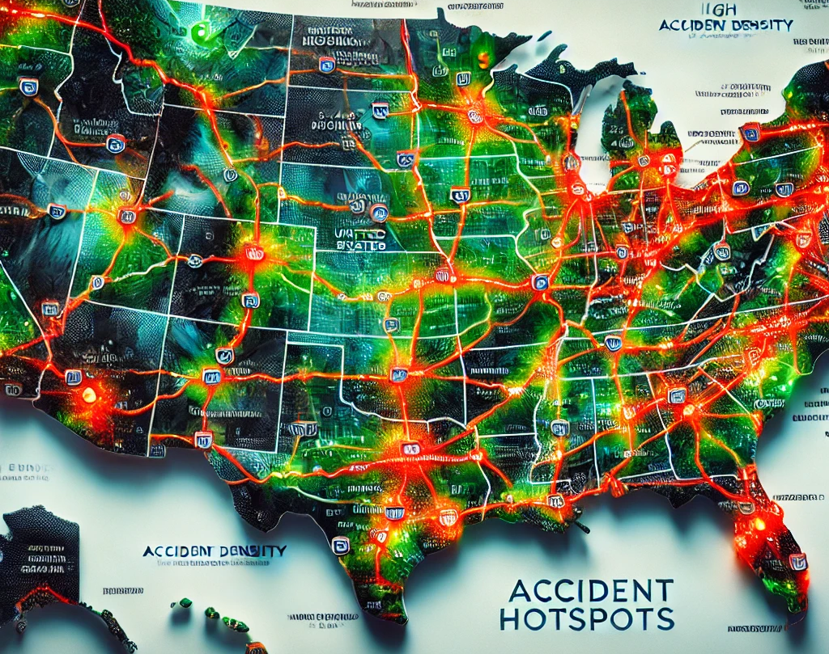
US Accidents (2016 – 2023)
By :-
Pratik Harlikar,
Aditya Jadhav,
Yatziri Presmont,
Muhammad Batikh

Slide 3

Introduction
Focus on Traffic Safety: The US Accidents Data Analysis project explores traffic accident patterns across the United States, aiming to uncover the primary causes of road incidents and identify geographical and temporal trends.
Data Mining for Insights: By applying data mining techniques like classification, clustering, and anomaly detection, the project identifies patterns and factors contributing to accidents.
Comprehensive Dataset: The analysis leverages a dataset of over 7.7 million traffic accident records spanning 49 states from February 2016 to March 2023.
Predictive Modeling: The project develops predictive models to estimate the probability of accidents based on various parameters, enabling proactive strategies for risk mitigation.
Actionable Insights: Insights derived from the models can inform strategies for accident prevention, including recommendations for policymakers, urban planners, and transportation authorities.
Goal: To enhance road safety, reduce accident frequencies, and minimize their impact on public health and infrastructure through data-driven decision-making.

Slide 4

Problem Statement
Traffic accidents remain a critical public safety issue in the United States, resulting in substantial fatalities, injuries, and economic burdens each year. According to the CDC (Centers for Disease Control and Prevention), in 2023 alone, there were 44,534 deaths caused by traffic accidents, equating to a mortality rate of 13.4 deaths per 100,000 population in a nation with a population of 345,426,571. This highlights the urgent need for advanced data-driven approaches to understand accident patterns, predict hotspots, and mitigate risks, aiming to save lives and reduce economic losses.

Slide 5

Motivation
With 44,534 fatalities in 2022, traffic accidents not only cause a serious loss of life, but they also have a substantial negative emotional and financial impact on society. With more than 345 million people living in the United States, it is critical to identify, forecast, and reduce accident hotspots as soon as possible. To improve road safety and lower fatalities, we can apply data mining techniques and advanced models of machine learning to find patterns, forecast high-risk regions, and create useful insights. The purpose of this research is to show how data-driven methods may turn accident data into solutions that can save lives.

Slide 6
Dataset Overview and Characteristics
Dataset Scope:
The US Accidents dataset encompasses over 7.7 million traffic accident records collected from February 2016 to March 2023, spanning 49 states and offering a comprehensive view of traffic patterns across the U.S. To ensure computational efficiency, a subset of 10,000 records was analyzed, retaining significant insights while optimizing processing.
Data Sources:
The dataset, sourced from Kaggle, aggregates information from diverse public feeds, including law enforcement reports, traffic sensors, cameras, and data from US and state Departments of Transportation. The integration of these varied sources ensures a robust and multi-faceted dataset for comprehensive analysis.
Key Attributes:
Key attributes include accident location (latitude and longitude), occurrence time, weather conditions (temperature, wind speed, visibility), and severity classifications.
These attributes allow for in-depth analysis of factors contributing to traffic accidents.

Slide 7

What Types Data
Numerical Data
Categorical Data
Includes continuous variables such as temperature, visibility distance, and speed limits. These quantitative measures provide precise insights into environmental conditions during accidents.
Encompasses qualitative attributes like weather conditions (e.g., sunny, rainy, foggy) and accident severity levels. These categories allow for classification and pattern recognition in accident occurrences.
Temporal Data
Geospatial Data
Captures the time and date of accidents, enabling analysis of trends across different time scales (hourly, daily, seasonal). This temporal dimension is crucial for understanding accident frequency patterns.
Includes location coordinates and road type information, facilitating geographical analysis and identification of accident-prone areas or road segments.

Slide 8




Data Mining Task: Classification Approaches
Problem Definition
Multiclass Classification
Binary Classification
Model Selection and Evaluation
The primary data mining task is classification, focusing on predicting accident severity based on various input features. This task can be approached as either a multiclass or binary classification problem, depending on the specific research objectives and desired granularity of results.
In this approach, accidents are classified into multiple severity levels, typically ranging from minor to fatal. This method provides a more nuanced understanding of accident outcomes but may require more complex models and larger datasets for accurate predictions.
As an alternative, the problem can be simplified to a binary classification task, distinguishing between severe (levels 3 and 4) and non-severe (levels 1 and 2) accidents. This approach may offer more robust predictions, especially with limited data, but at the cost of less detailed severity information.
Various classification algorithms, such as decision trees, random forests, and support vector machines, will be evaluated. Model performance will be assessed using metrics like accuracy, precision, recall, and F1-score, with cross-validation to ensure robustness.

Slide 9

Methodology

Slide 10
Attribute Selection and Justification
1
Critical Attributes
2
Excluded Attributes
Selected attributes include time of accident, geographical coordinates, weather conditions, and road characteristics. These factors are crucial for understanding the circumstances surrounding each accident and their potential impact on severity.
Non-informative attributes such as unique identifiers and redundant location information were omitted to streamline the analysis and improve computational efficiency. This selective approach ensures focus on the most relevant factors affecting accident outcomes.
3
Predictive Power
4
Data Quality Considerations
Attributes were chosen based on their potential predictive power in accident severity classification. Factors known to significantly influence accident likelihood and severity, such as visibility and traffic conditions, were prioritized in the selection process.
The selection process also considered the quality and completeness of data for each attribute. Attributes with high rates of missing values or inconsistent reporting were carefully evaluated before inclusion in the final analysis set.

Slide 11
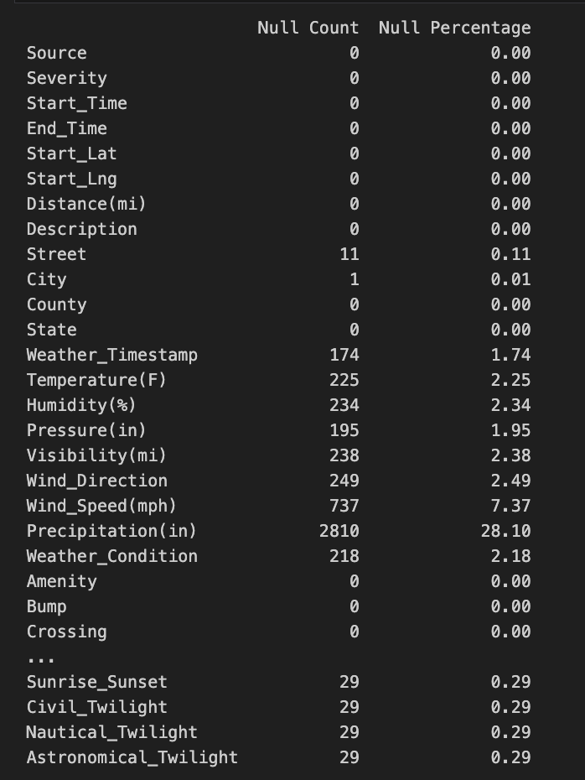
1
Handling Missing Values
Objective of Handling Missing Values:
To ensure data quality and integrity for analysis and modeling.
Reduce bias and inaccuracies caused by missing or incomplete data.
Approach Taken:
Mean Imputation: For numerical columns, missing values were replaced with the mean of the column.
Mode Imputation: For categorical columns, missing values were replaced with the most frequently occurring value.
Critical Removal: Entries with substantial missing data were removed to prevent skewing results.
Results:
A significant reduction in missing data improved dataset readiness for analysis and modeling.

Slide 12
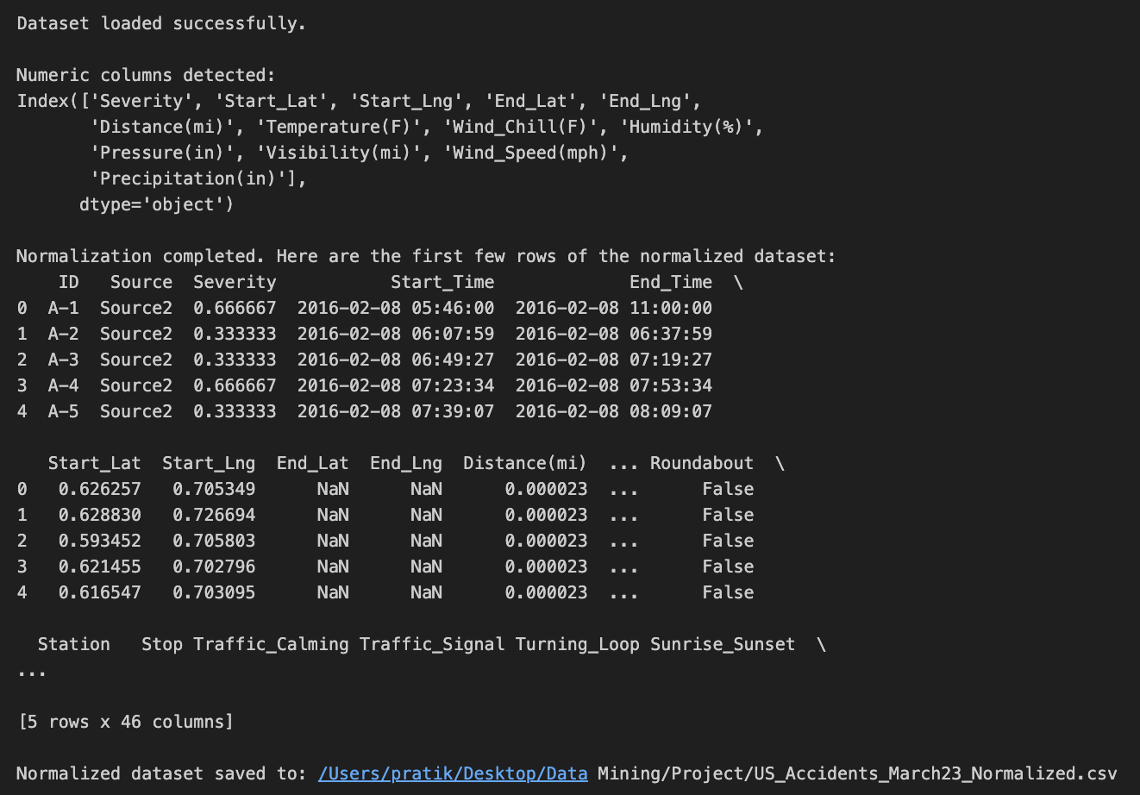
2
Feature Engineering and Encoding
Categorical Feature Encoding:
Utilized label encoding for high-cardinality categorical features.
Applied one-hot encoding for categorical variables with fewer unique values to maintain data granularity
2. Numerical Feature Normalization:
Leveraged StandardScaler and MinMaxScaler to normalize numerical features, ensuring uniform feature scaling and enhancing model performance
Insight :
These steps aimed to ensure the dataset's compatibility with algorithms, improve computational efficiency, and support accurate predictive modeling.

Slide 13
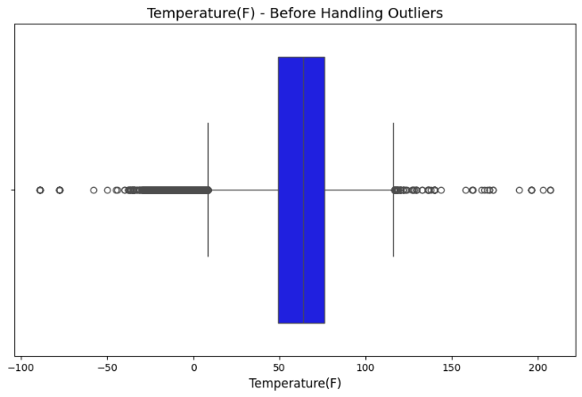
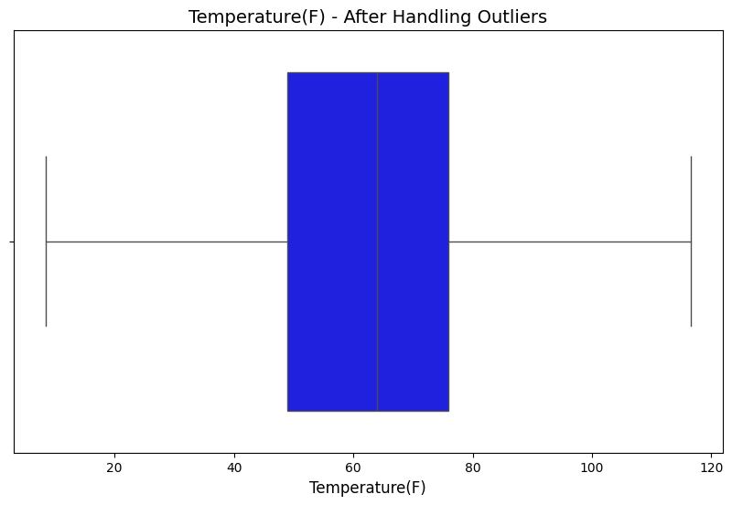
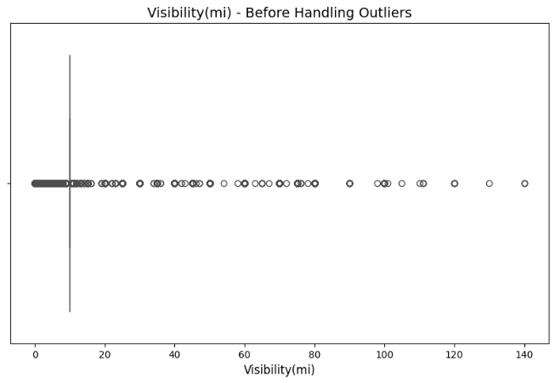
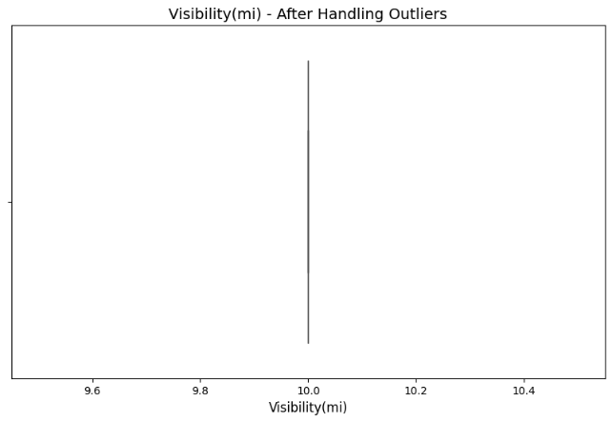
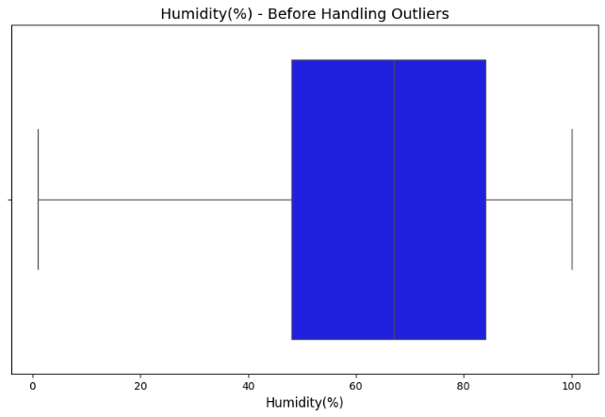
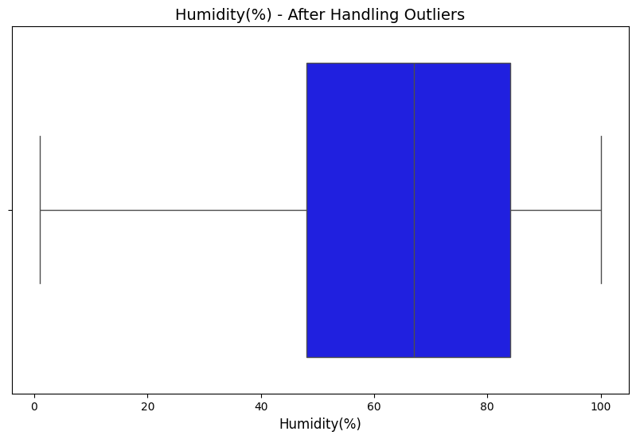
3
Anomaly Detection & Treatment
Utilized the Interquartile Range (IQR) method to identify outliers in key numerical features. Outliers were either removed or capped at appropriate thresholds to ensure data consistency and prevent skewed analysis results.
Temperature (°F):Extreme values beyond -50°F and 150°F were treated as unrealistic and addressed.
Visibility (mi):Unusual values exceeding 50 miles were identified and capped.
Humidity (%):Data primarily lies between 50% and 90%. Outliers were capped for consistency.

Slide 14
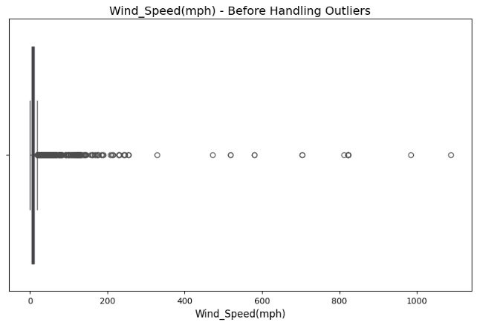
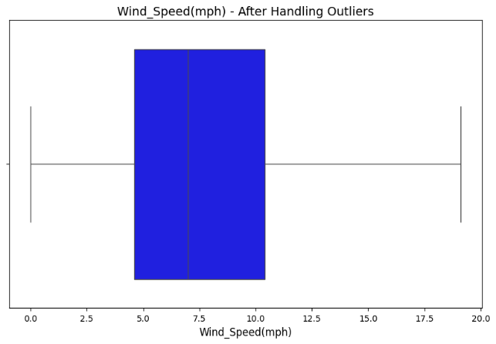
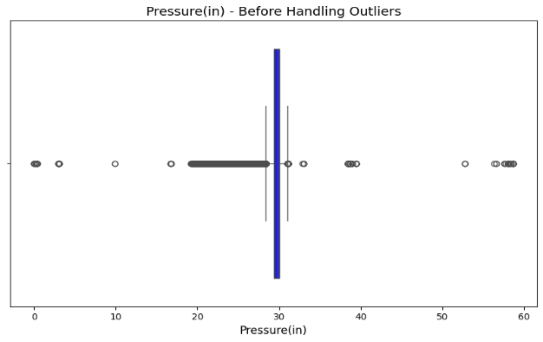
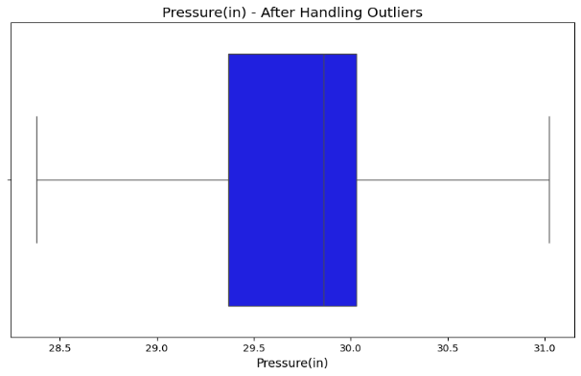
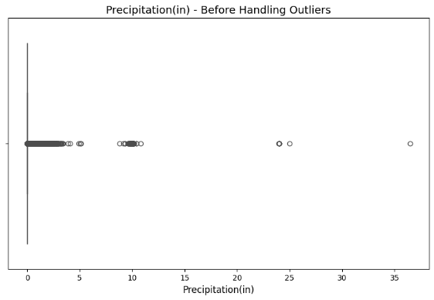
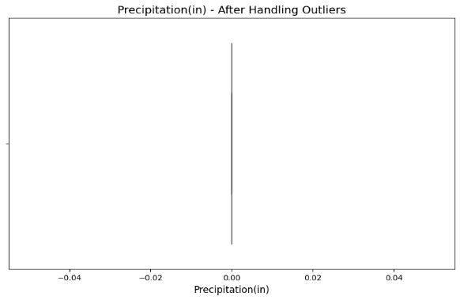
Wind_Speed(mph): Wind speed values above 100 mph were considered unrealistic for the dataset. Post-handling, values range reasonably between 5 and 17 mph.
Pressure(in): The pressure values after handling fall within 28.5 to 31 inches, removing the unrealistic outliers that could potentially skew the analysis.
Outlier Treatment
Capping Outliers capped to nearest acceptable values within IQR range to reduce skewness. Standardization
Data brought within reasonable ranges for more accurate representation of accident conditions.
Consistency
Extreme values removed to ensure more consistent weather and distance data.
Precipitation (in): Precipitation above 5 inches was capped to avoid data skewness.

Slide 15
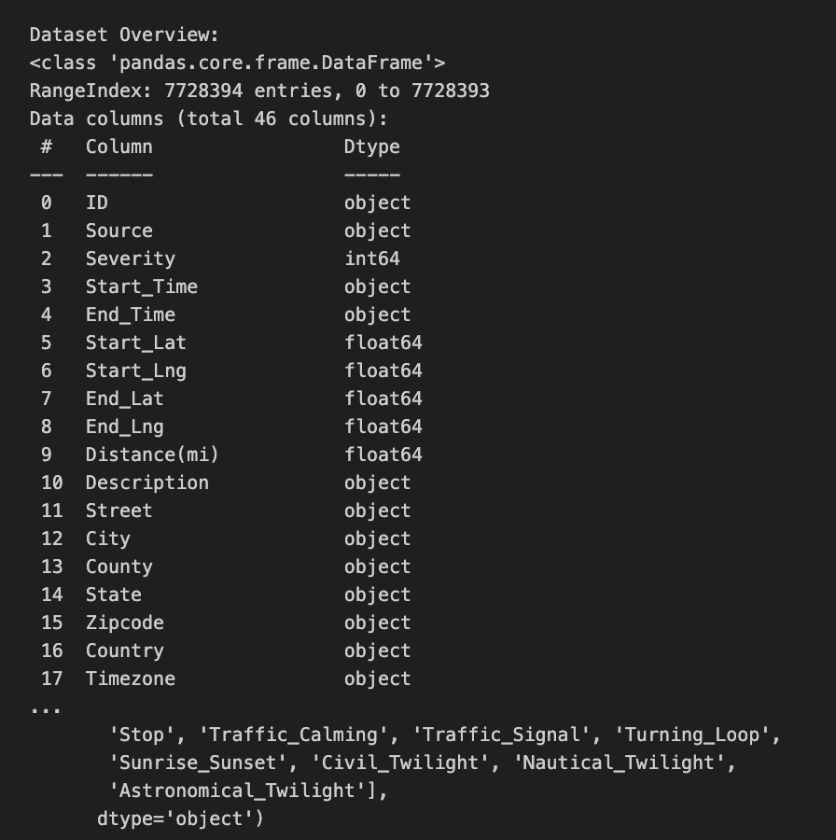
4
Exploratory Data Analysis (EDA)
Conducted comprehensive EDA using data summarization techniques and visualization methods such as heatmaps, scatter plots, and boxplots to uncover initial patterns and relationships within the dataset.
Purpose:
To uncover patterns, detect anomalies, and identify relationships between variables.
To Provide a summary of data characteristics to guide further processing and analysis.
Technique:
Data Summarization:
Inspection of data types and column names.
Statistical summaries of numerical and categorical features.

Slide 16
Temporal Trends in Accidents
Yearly Trends
State-wise Distribution
Top 20 States
Analysis of accident data reveals an increasing trend over the years, with a peak observed in 2021. This rise could be attributed to various factors such as changes in traffic volumes, road conditions, or weather patterns. Notably, there's a significant drop in 2023, which may reflect incomplete data collection or changes in reporting practices.
A pie chart analysis shows that California leads with the highest percentage of accidents (22.7%), followed by Texas (18.2%), Florida (13.6%), and New York (13.6%). States like Illinois, Ohio, and Oregon each account for smaller shares of around 4.5%. This distribution correlates strongly with population size and traffic density in these states.
A bar chart highlighting the top 20 states with the most accidents further emphasizes the dominance of California, Florida, and Texas. This visualization clearly identifies where most accidents occur, providing crucial information for spatial analysis and targeted safety interventions.

Slide 17
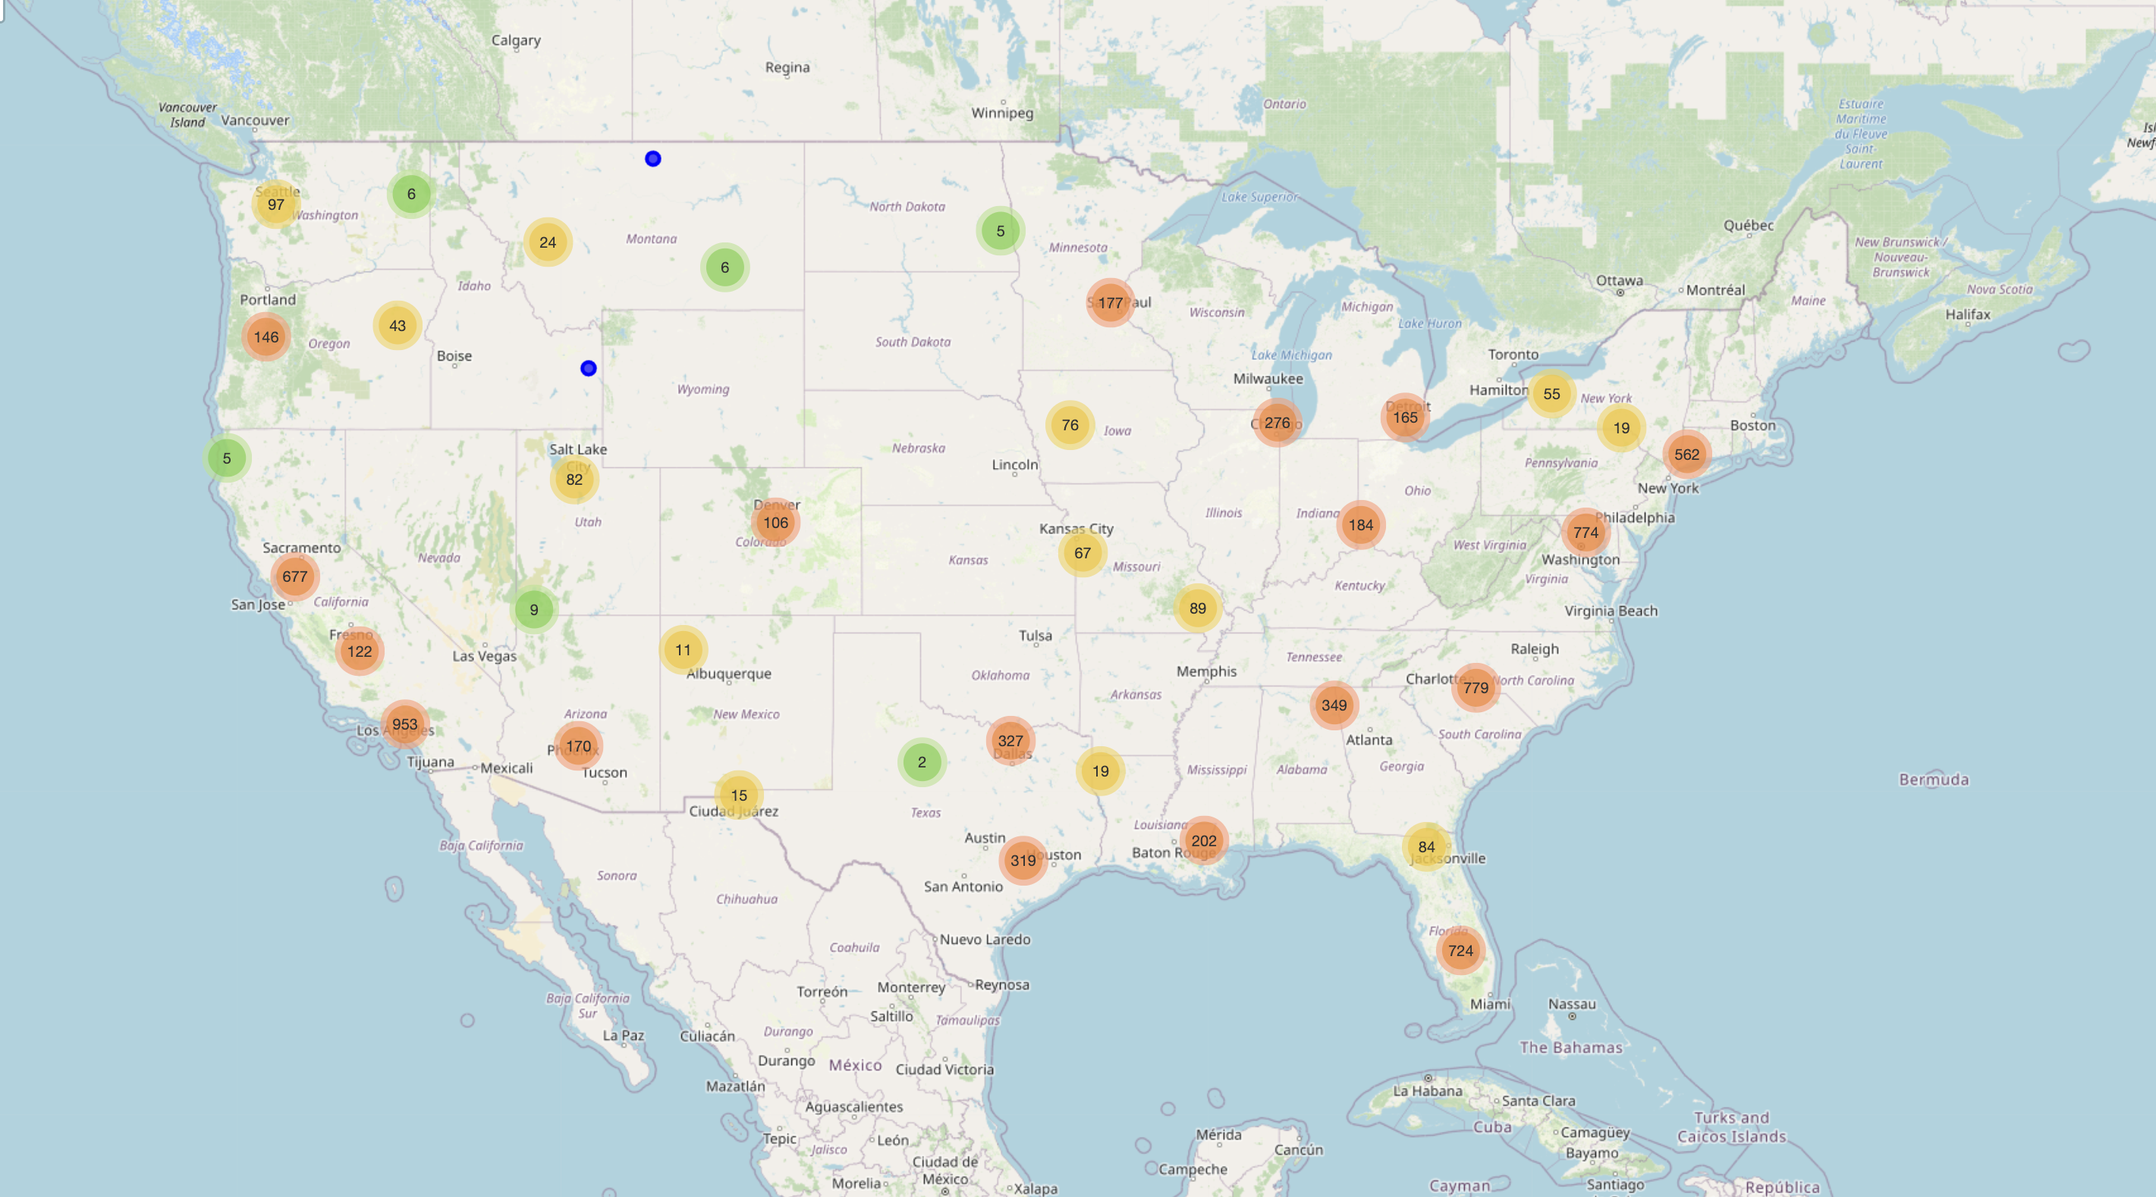
Visualizations
Geographical accident density map

Slide 18
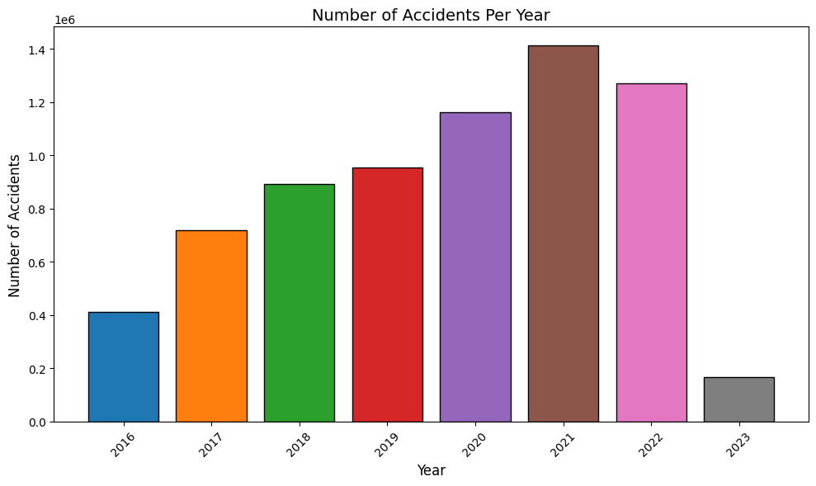
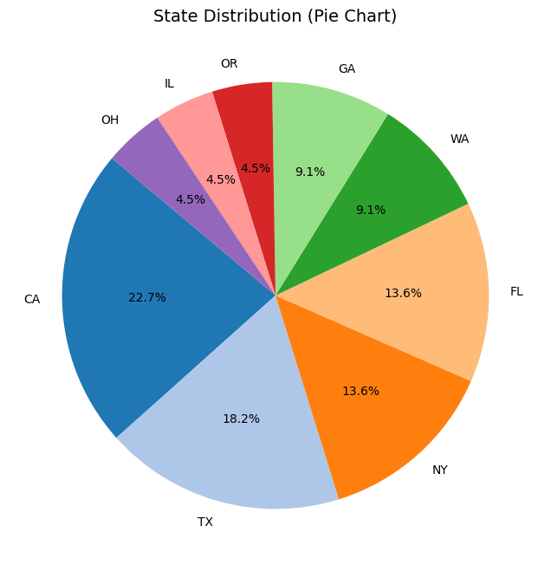
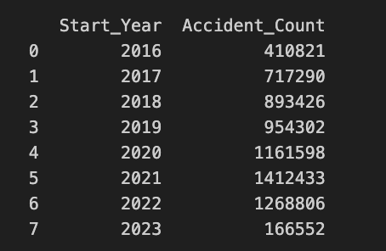
Accident trends by Year And State

Slide 19
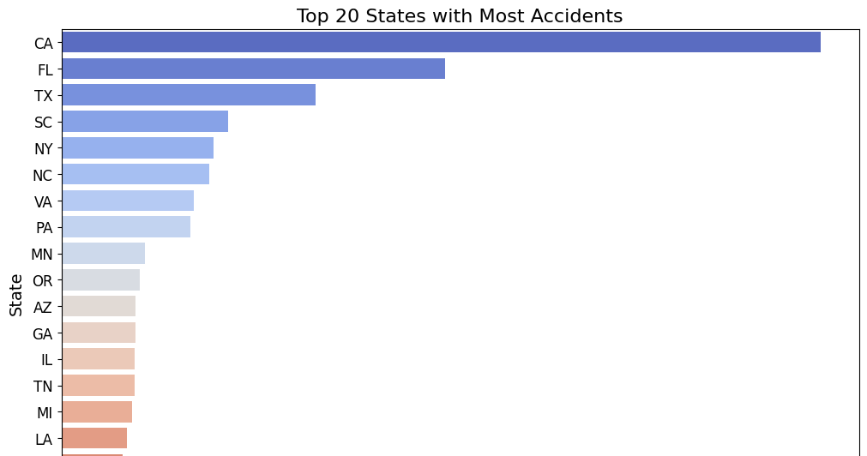

Slide 20

Targeting Solo State “Texas”

Slide 21
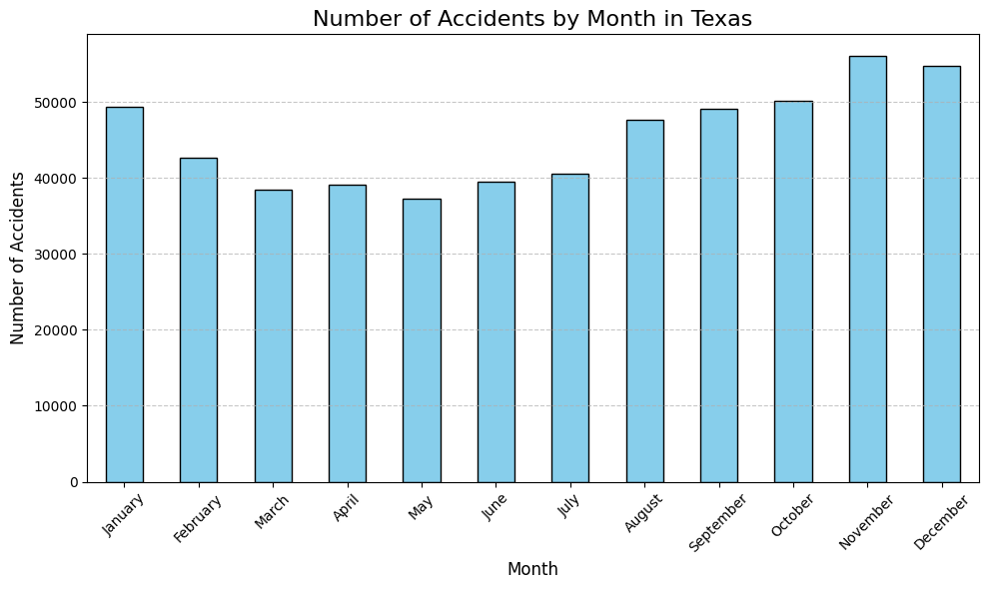
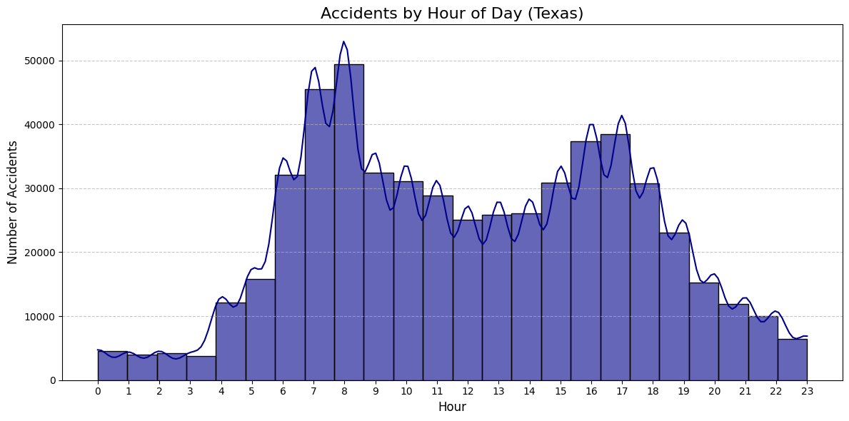
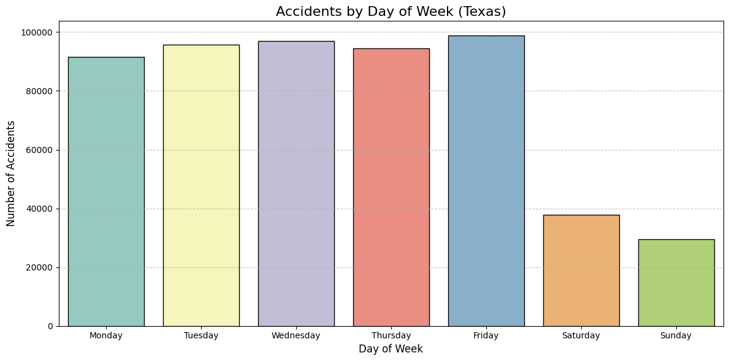

Slide 22
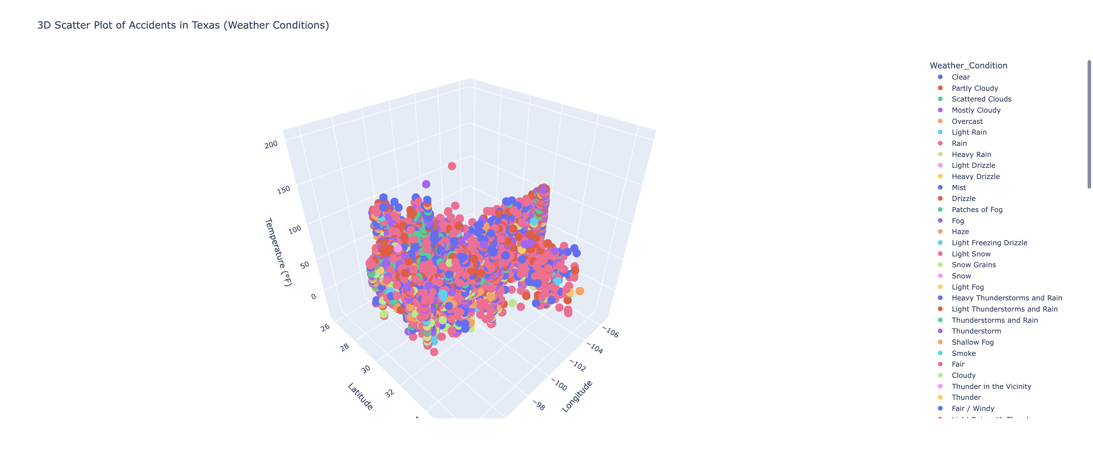
Accident caused in Texas due to
weather conditions
Top 3 Weather Conditions for Accidents:
Rainy Conditions
Foggy Conditions
Overcast or Cloudy Weather

Slide 23

Models And Analysis

Slide 24
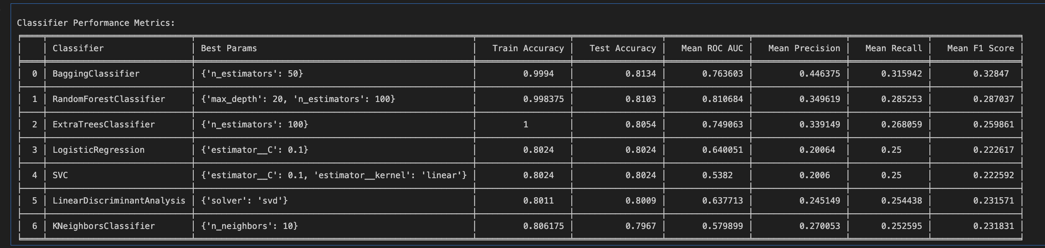
Bagging Classifier : For handling variance and bias.
Random Forest: Ensemble learning model for robust classification.
Extra Trees Classifier : Ensures computational efficiency with a focus on feature randomness.
Logistic Regression: For feature reduction and classification.
Support Vector Machines (SVC): Effective in high-dimensional spaces.
Linear Discrimination Analysis (LDA) : Useful for dimensionality reduction in classification tasks.
K-Nearest Neighbors (KNN): Simplicity in prediction.
1. Overview of Models Used
models applied in the project:

Slide 25
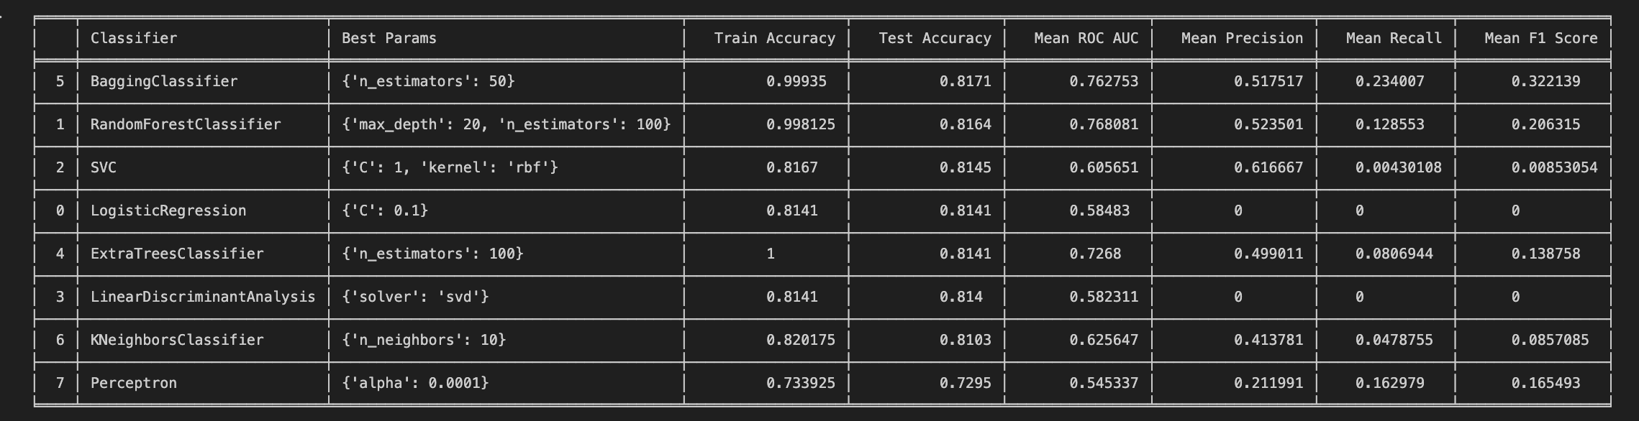
Key Metrics Evaluated
Accuracy: The percentage of correctly predicted observations.
Precision: The ratio of true positive predictions to all positive predictions.
Recall: The ability of the model to detect all actual positives.
F1 Score: The harmonic mean of precision and recall.
ROC-AUC: The area under the receiver operating characteristic curve.
2. Performance Metrics

Slide 26
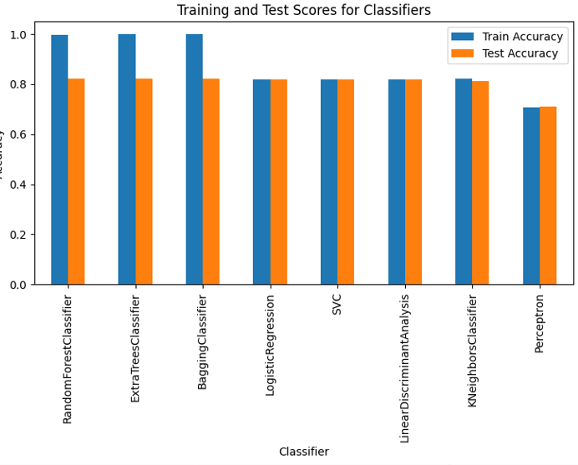
Binary Classifier Performance
Model
Test Accuracy
F1 Score
RandomForestClassifier
0.8224
Highest
ExtraTreesClassifier
High
Balanced
Perceptron
Lower
Limited

Slide 27
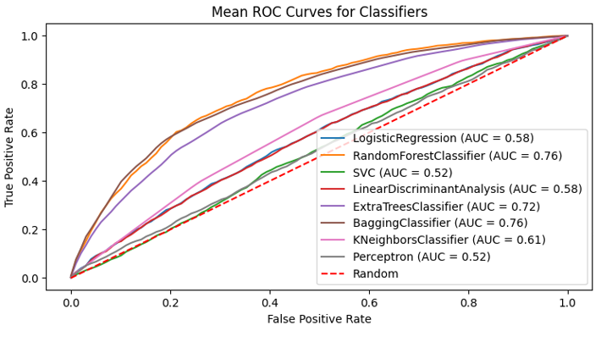



Binary Classifier
ROC Curves
AUC Range
AUC values range from 0.52 to 0.76, higher values indicating better performance.
Top Performers
Random Forest and Bagging Classifier show highest AUC values of 0.76.
Interpretation
Curves closer to top-left corner indicate higher sensitivity and specificity.

Slide 28
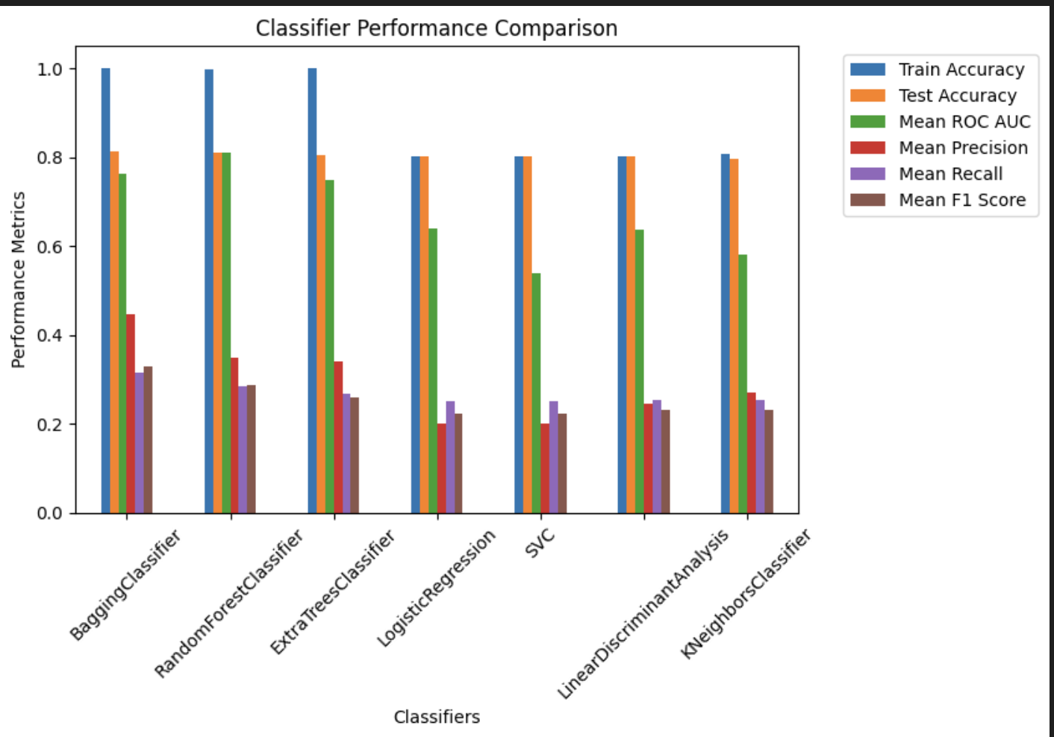
Multiclass Classifier Performance
Model
Test Accuracy
F1 Score
RandomForestClassifier
0.81
High
Bagging Classifier
0.81
Highest
SVC
0.54
Lowest

Slide 29
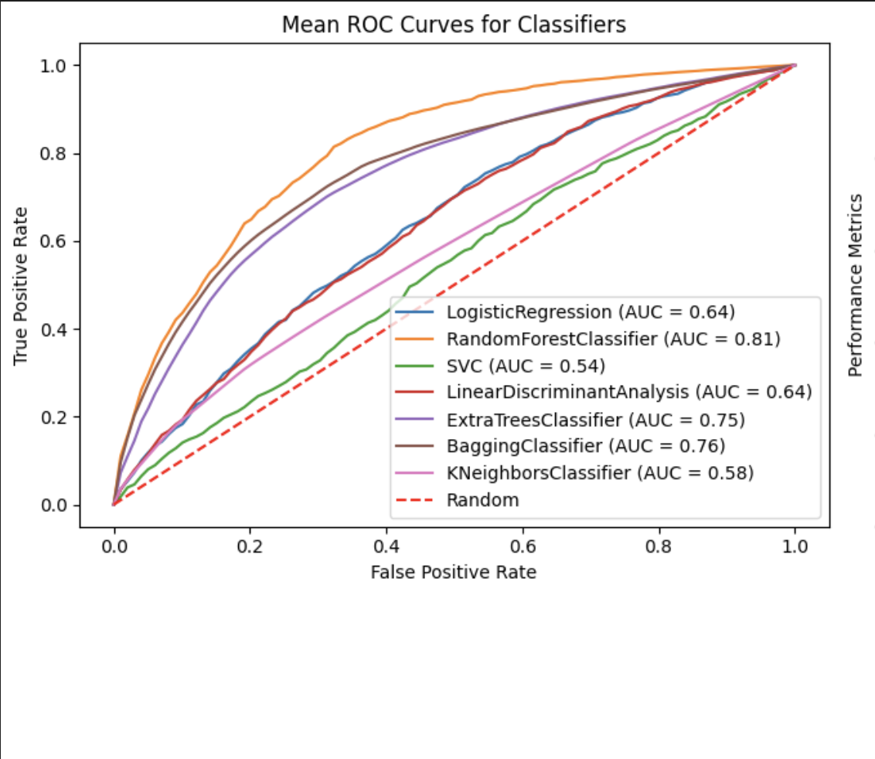
Multiclass Classifier
ROC Curves
AUC Range
AUC values range from 0.54 to 0.81, higher values indicating better performance.
Top Performers
Random Forest and Bagging Classifier show highest AUC values of 0.81 and 0.76 Respectively
Interpretation
Curves closer to top-left corner indicate higher sensitivity and specificity.

Slide 30
Binary Classification VS Multiclass Classification
Binary Classification
Multiclass Classification
Top Performers
Focus & Challenge
Key Strengths
Random Forest Classifier and Bagging Classifier excelled with high AUC values (~0.76) and balanced F1 Scores.
Random Forest Classifier and Bagging Classifier achieved the highest AUC values (~0.81) for classifying into multiple severity levels.
Simplifies the prediction task by classifying accidents as severe or not severe, improving interpretability.
Increased complexity with multiple classes reduces precision and recall slightly compared to binary classification.
Demonstrates superior performance in identifying accident severity with higher precision and recall metrics.
Provides more granular insights into accident severity, aiding in more detailed analysis and prevention strategies.
Insights:
Binary classification provides streamlined insights and higher model accuracy for broad-level insights.
Multiclass classification offers a detailed breakdown but demands more computational resources and fine-tuning.

Slide 31
Analysis of US Accidents dataset revealed key factors influencing accident frequency and severity, including weather, time of day, and location.
High accident rates observed during peak traffic hours and adverse weather conditions suggest need for targeted interventions.
Binary classification simplifies prediction and is ideal for high-level decision-making.
Multiclass classification provides detailed insights into accident severity levels, beneficial for targeted interventions.
Conclusion

Slide 32

Questions

Slide 33

THANK YOU

